Slide 1


HR ANALYSIS
BY ANI

Slide 2
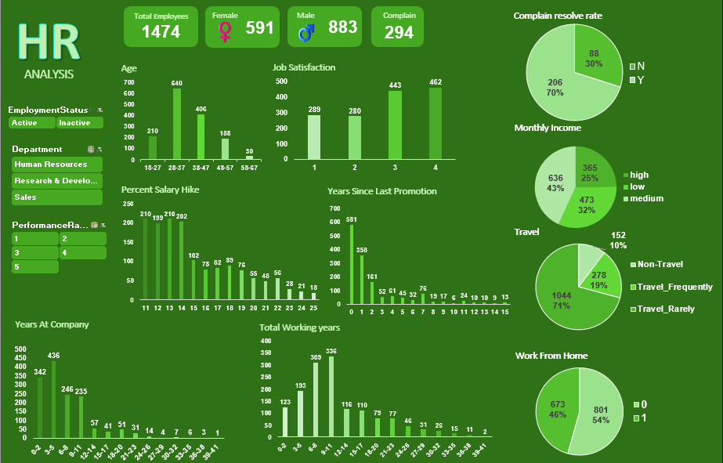
OVERVIEW
This Dashboard shows important insight on the data given
84% Active represent current employees and 16% Inactive represent employee who have left the organization
The following columns where not represented
Over 18 – contains only yes
Standard Hours – Contains similar figures 40hrs
Distance From Home – Contains information on ever employee even those who work from home
Number Of Companies worked – This represents employee experience. Total working years also represent experience

Slide 3
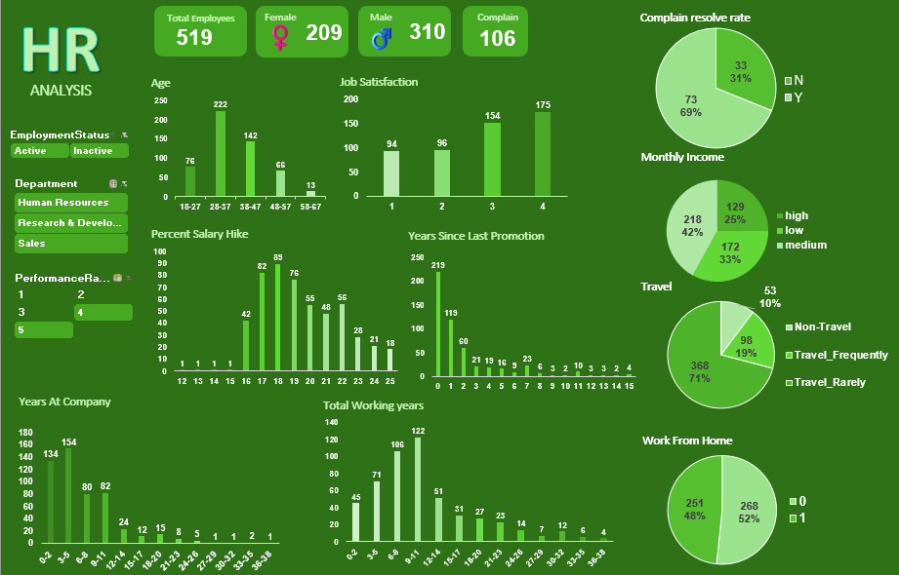
HIGH PERFORMING EMPLOYEE OVERVIEW
This Dashboard shows important insight on high performing employees active and inactive.
Employees with a performance score of 4 or 5 are considered high performers.
There are 519 people in this group, the majority of whom are between the ages of 28 and 37. 33% of the employees are extremely content with their jobs, 48% are satisfied, and 18% are dissatisfied. Sixty-nine percent of their complaints were handled, leaving 31% unresolved. 48% work from home, 52% work at the office, and 19% travel frequently, while 71% travel rarely for business purposes. 42% have never been promoted. 99% of employees have seen a wage increase of more than 16%. 75% have been with the company for three years or more. 8% have 0-2 years of experience, while 92% have 3 years or more. 33% earn low, 42% earn middle, and 25% earn high.

Slide 4
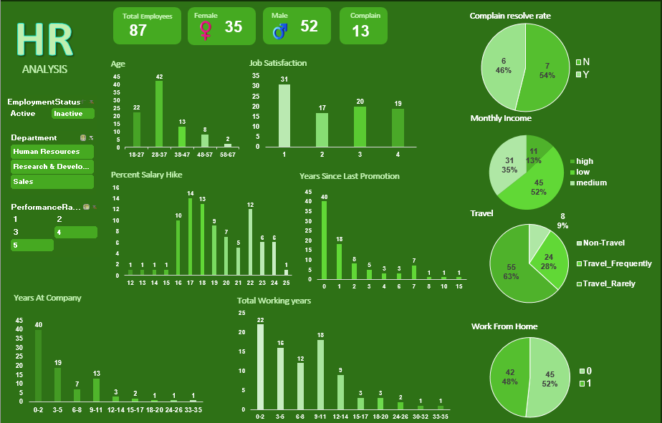
INACTIVE HIGH PERFORMING EMPLOYEE OVERVIEW
This Dashboard shows important insight on Inactive high performing employees
There are 87 employees in this category, with 41% females and 59% males. The majority of them are between the ages of 28 and 37.
21% of employees are very satisfied with their jobs, 43% are satisfied, and 37% are dissatisfied.46% of their complaints were handled, while 54% remained unresolved. 48% work from home, 52% work in an office, and 28% travel frequently, while 63% travel rarely for professional purposes.
45% have received no promotion at all. 95% of employees have seen a wage increase of more than 16%. 54% have been with the company for three years or longer. 25% have 0-2 years of experience, while 75% have 3 years or more. 52% earn low, 35% earn medium, and 13% earn high.
16 % high performance staff left the organization

Slide 5
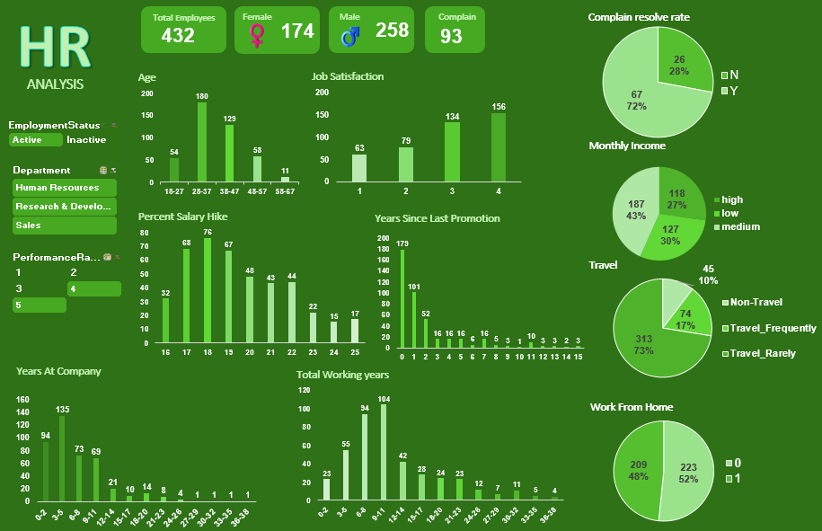
ACTIVE HIGH PERFORMING EMPLOYEE OVERVIEW
This Dashboard shows important insight on active high performing employees
There are 432 employees in this category, with 174 females and 258 males. The majority of them are between the ages of 28 and 37.
36% of employees are very satisfied with their jobs, 49% are satisfied, and 14% are dissatisfied.67% of their complaints were handled, while 28% remained unresolved. 48% work from home, 52% work in an office, and 17% travel frequently, while 73% travel rarely for professional purposes.
41% have received no promotion at all. 100% of employees have seen a wage increase of more than 16%. 78% have been with the company for three years or longer. 5% have 0-2 years of experience, while 95% have 3 years or more. 30% earn low, 43% earn medium, and 27% earn high.
There are 83% high performance staff

Slide 6
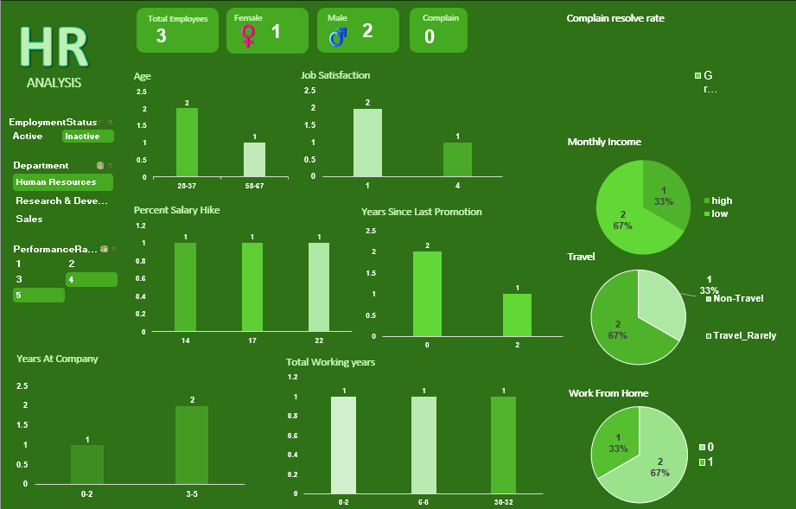
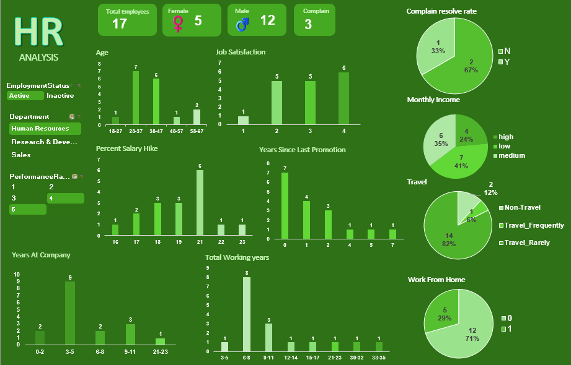
HR DPT HIGH PERFORMING EMPLOYEE OVERVIEW
This Dashboards shows important insight on Inactive and active high performing employees in Hr department
There were 20 employees in this department, 15% left and 85% are active employees.

Slide 7
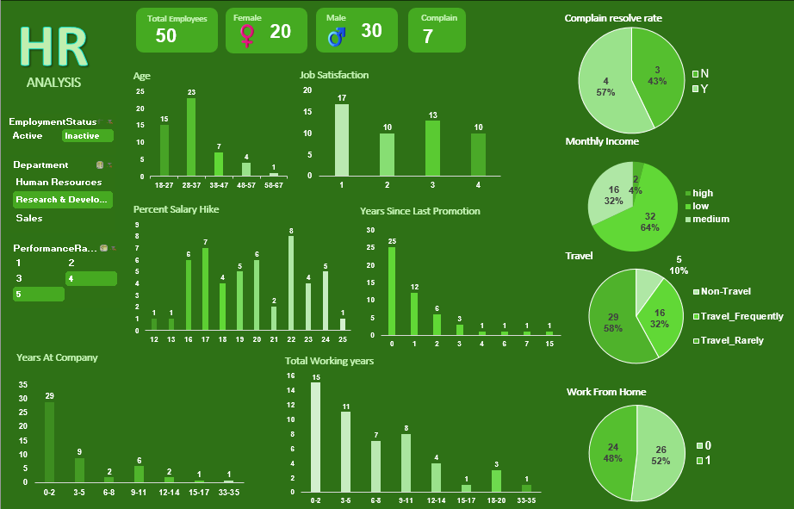
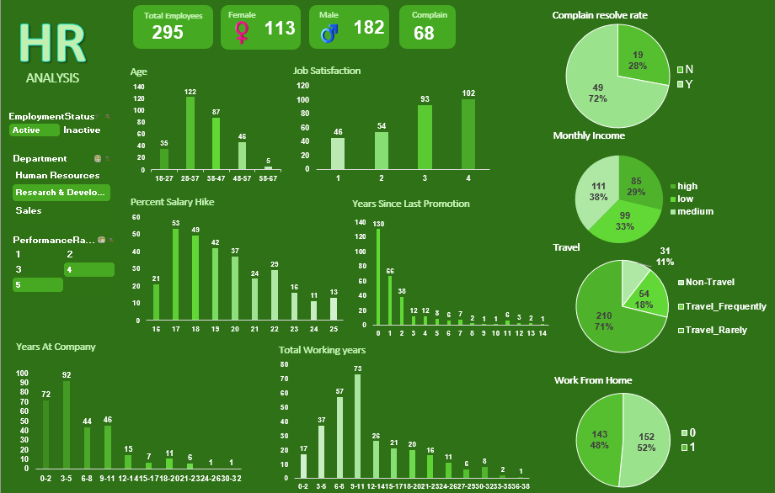
RESEARCH DPT HIGH PERFORMING EMPLOYEE OVERVIEW
This Dashboards shows important insight on Inactive and active high performing employees Research and Development
There were 345 employees in this department, 14% left and 86% are active employees.

Slide 8
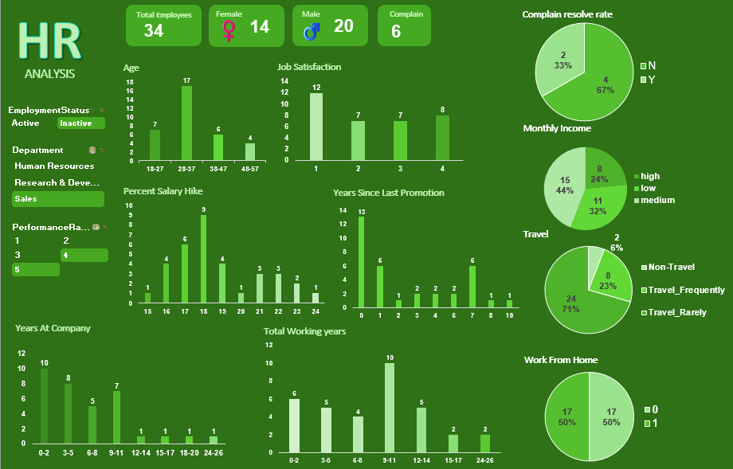
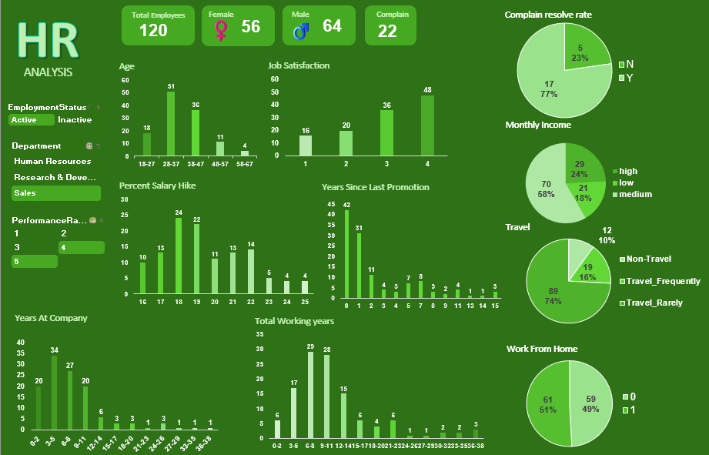
SALES DPT HIGH PERFORMING EMPLOYEE OVERVIEW
This Dashboards shows important insight on Inactive and active high performing employees sales
There were 154 employees in this department, 22% left and 77% are active employees.
Data demonstrates that sales had the greatest employee attrition rate.

Slide 9

PREDICTING EMPLOYEE
ATTRITION

Slide 10
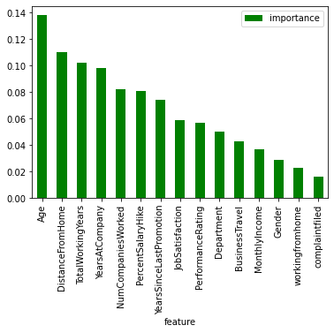
To predict if an employee is likely to leave the company, The important features of the data was identified using the random forest classification model
86.41% of the employees who left the organisation were accurately recognised by the model.
Age appears to be the most relevant factor, followed by distance from home, total working years, years at company, number of companies worked , percentage salary increase, and so on.

Slide 11
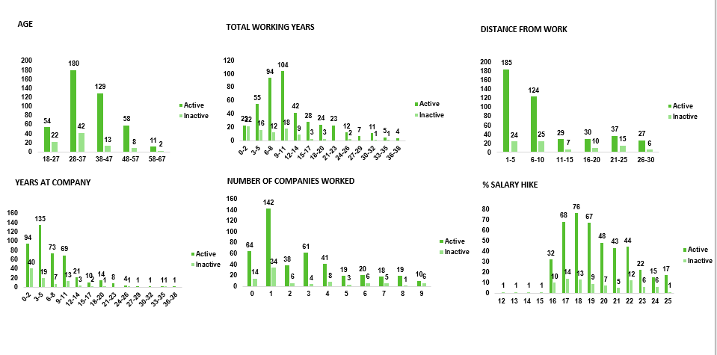
IMPORTANT FEATURES FOR HIGH PERORMANCE EMPLOYEES

Slide 12
CONCLUSION
Employees between the ages of 28 and 27 who have 0-2 years of work experience in the organisation and overall, have worked in only one company before working in the organisation, leave 1- 10 kilometres from the office, and have a salary increase of 17% to 18% are more likely to leave the organisation.

